Slide 1
DESIGN PATTERNS
08.05.2019
Design Patterns
Ramón Tomás
Software Engineer

Slide 2

Ramón Tomás
Software Engineer
Full-stack developer
Expert in .NET & Cloud solutions
https://www.linkedin.com/in/rtomasc/
rtomas@plainconcepts.com
@ramon_tomas84 (twitter)

Slide 3
Introduction
Creational Patterns
Structural Patterns
Behavioral Patterns
#MicroservicesEvent

Slide 4
1. Introduction

Slide 5
Introduction
A Design pattern is a general repeatable solution to a commonly occurring problem within a given context in software design.
List of tried and tested solutions in software design
In 1995, Book published by Erich Gamma, John Vlissides, Ralph Johnson, and Richard Helm. “Design Patterns: Elements of Reusable Object-Oriented Software”. (Gang of Four)
Design patterns can be grouped into three categories: creational, structural and behavioral.

Slide 6
2. Creational Patterns

Slide 7
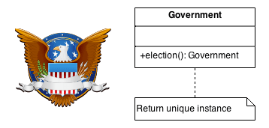
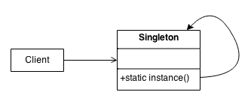
Singleton
A class has only one instance
Provides a global access point to this instance
Initialization on first use

Slide 8
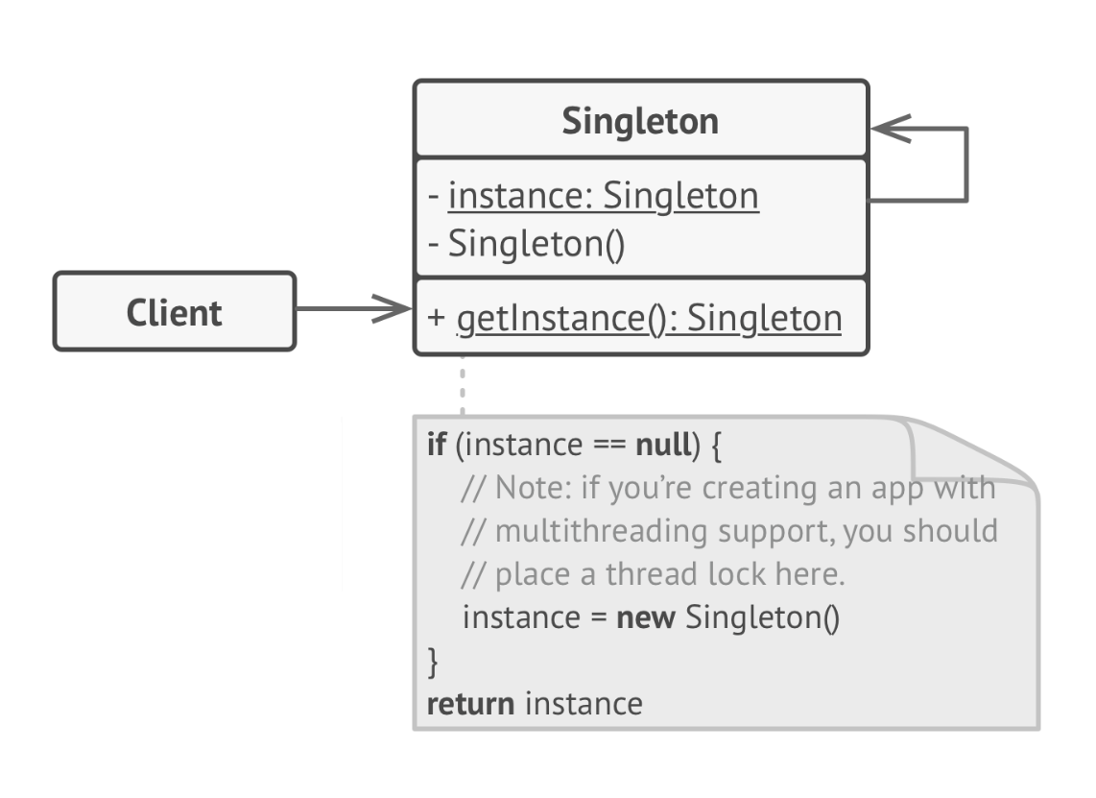
Singleton Structure

Slide 9

Singleton Characteristics
Ensure a class has only one instance
Global access point to that instance
Initialized just the first time is called
Ensures that a single instance is created but not a single thread is accessing at a time.
Violates the Single Responsibility Principle SOLID.
Difficult to Unit Test.

Slide 10
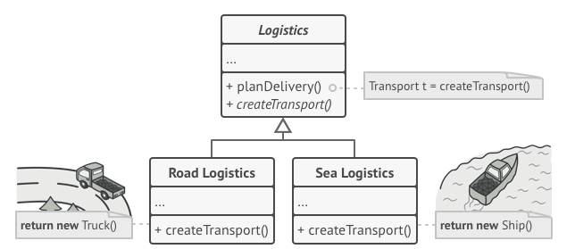
Factory Method
Defines an interface for creating objects
Subclasses decide which class to instantiate

Slide 11
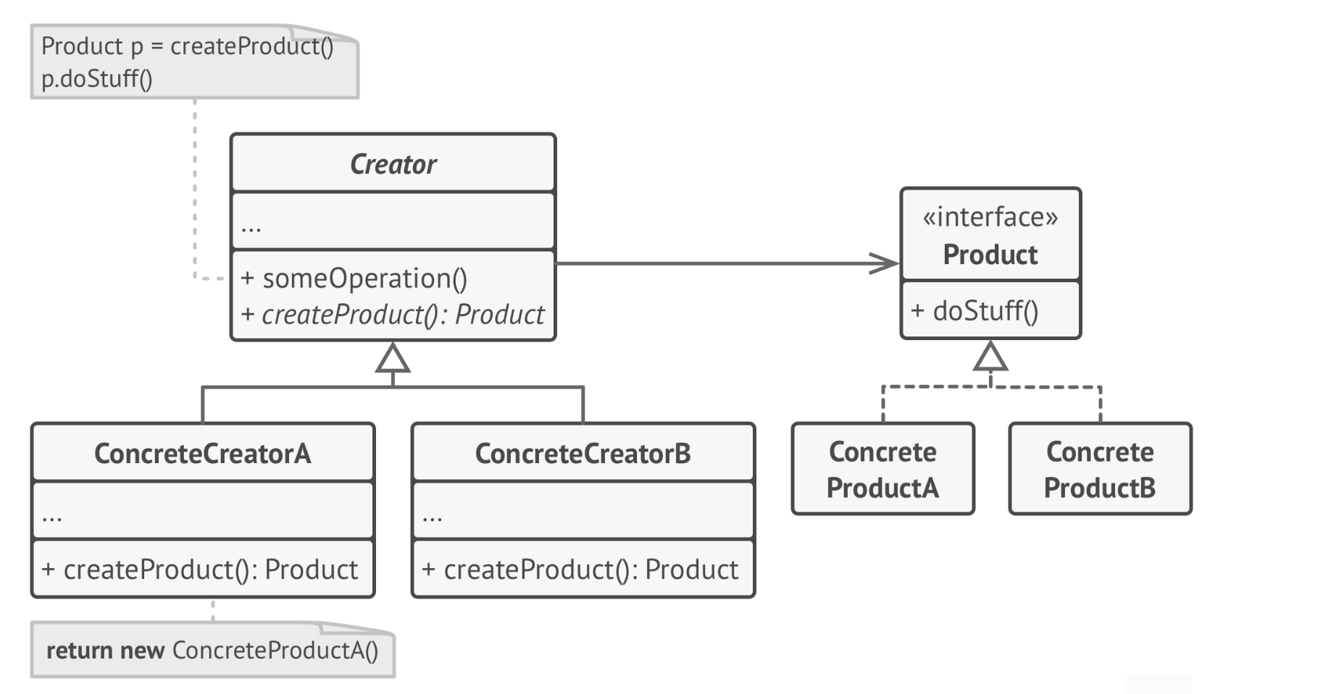
Factory Method Structure

Slide 12
Factory Method Characteristics
Client does not need to know about the complexities of creating classes.
Single Responsibility Principal. Delegates the responsibility of product creation to Factory methods.
Open/Close Principle. Introduction of new types of products without breaking changes.

Slide 13
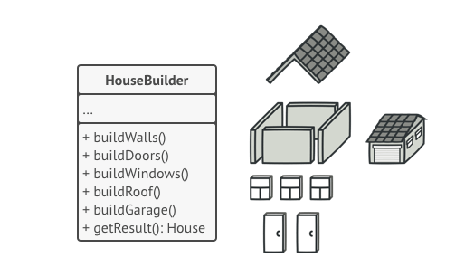
Builder
Construct complex objects step-by-step
Separates construction from representation
Same construction process can create different representations

Slide 14
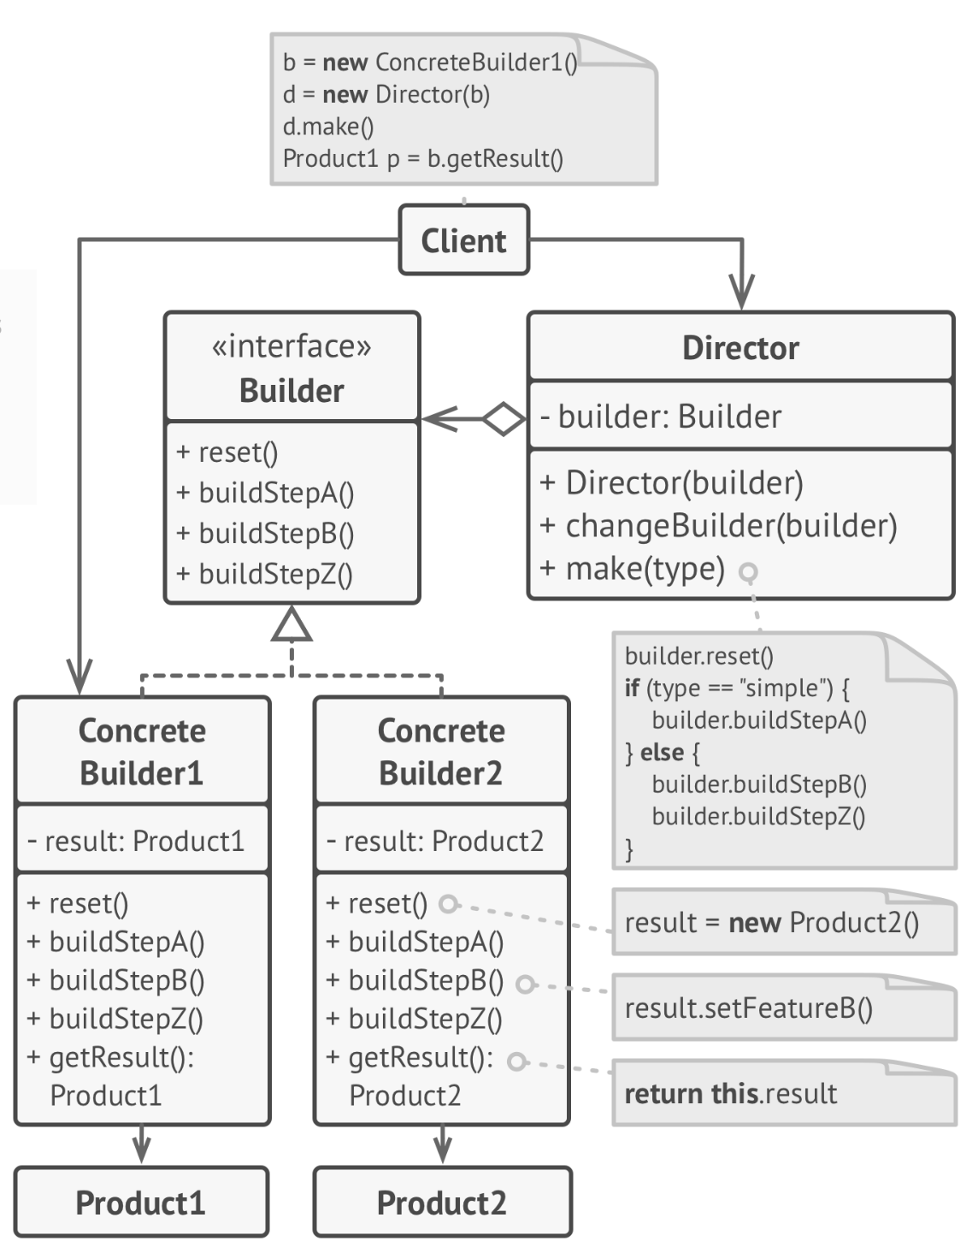
Builder Structure

Slide 15
Builder Characteristics
Single Responsibility Principal. Separates construction from representation.
Construct objects step-by-step, creating different representations of a complex object
Provides control over the steps of construction process

Slide 16
3. Structural Patterns

Slide 17
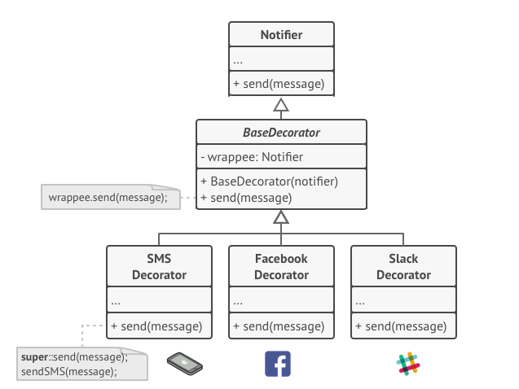
Decorator
Adds new behaviors to objects by wrapping these objects to special wrappers (decorators).
Recursive wrapping.
Provides a flexible alternative to subclassing for extending functionality.

Slide 18
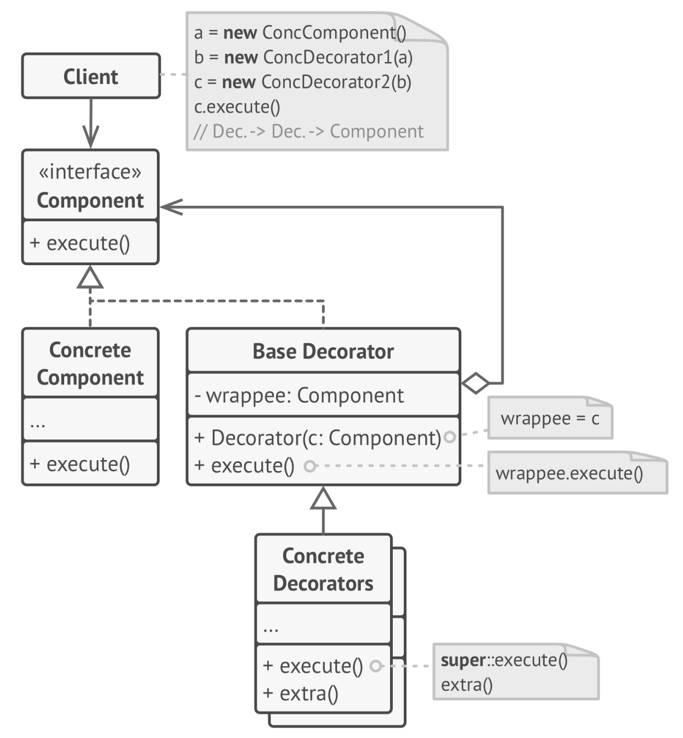
Decorator Structure

Slide 19
Decorator Characteristics
Combines several behaviors by wrapping an object into multiple decorators.
Extends behavior without having to create a new subclass
Single Responsibility Principle. Divide a class that implements many possible variants of behavior into smaller classes.
Code of layers might not look so nice
Order of execution depends on the order in the decorators stack

Slide 20
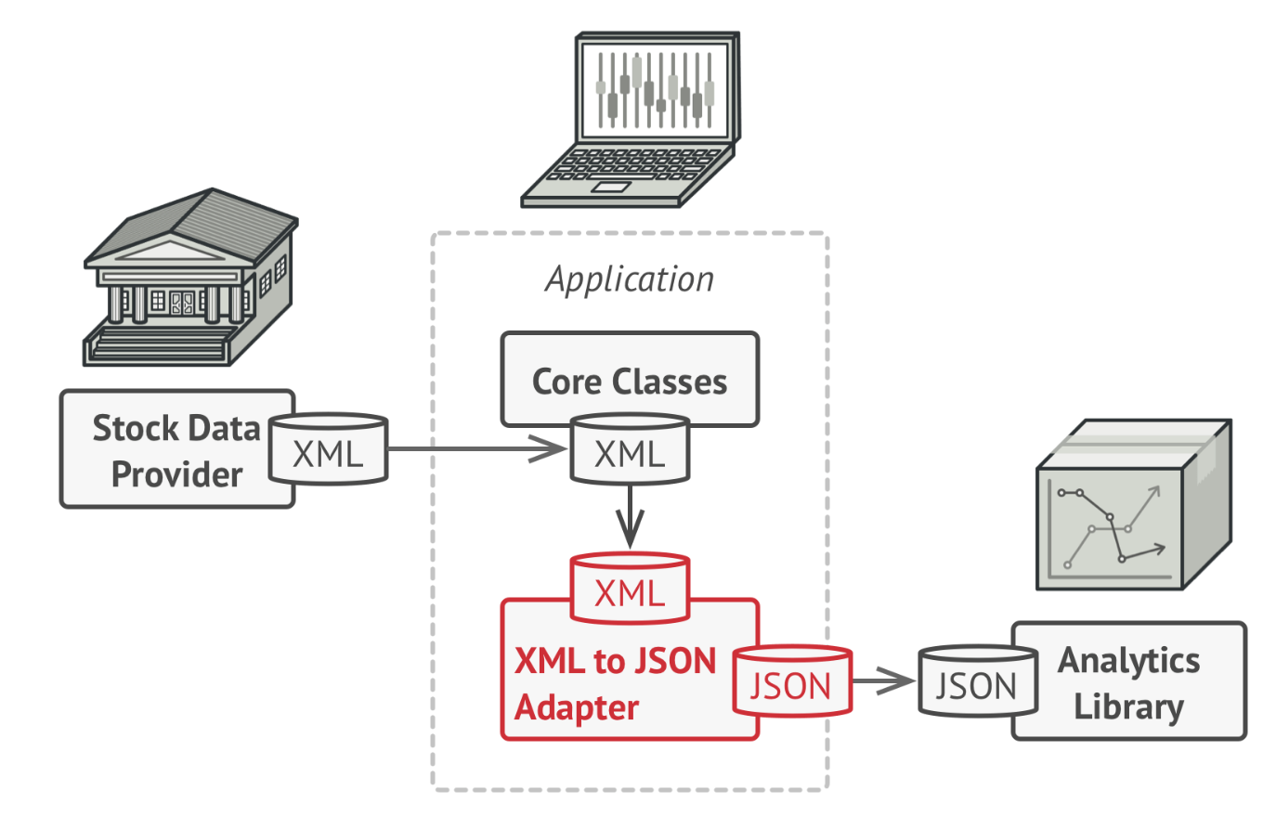
Adapter
Adapt classes with incompatible interfaces to work together.
Convert the interface of a class into another interface the client expects.

Slide 21
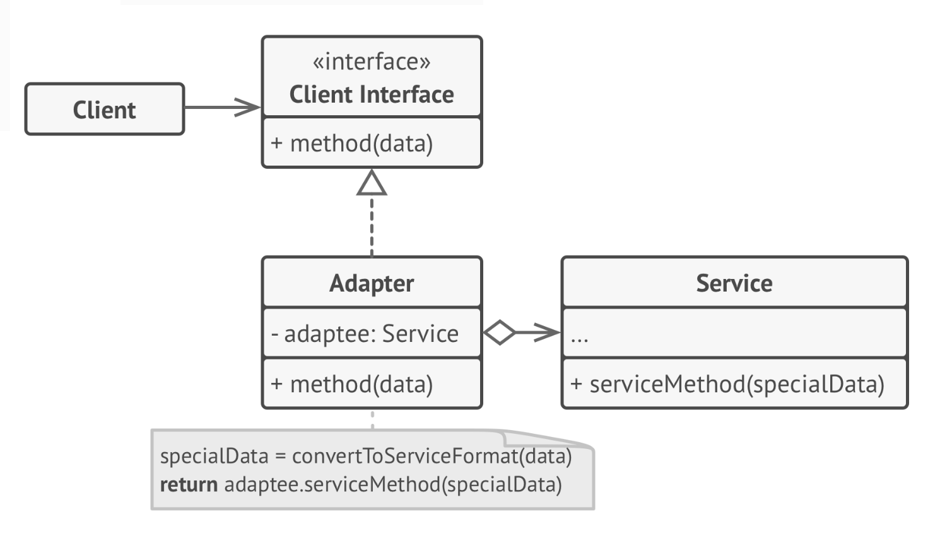
Adapter Structure

Slide 22
Adapter Characteristics
Open-Closed principle. Introduction of new types of adapters do not break the existing client code.
Single Responsibility Principle. Separates the data conversion code from the existing business logic.

Slide 23
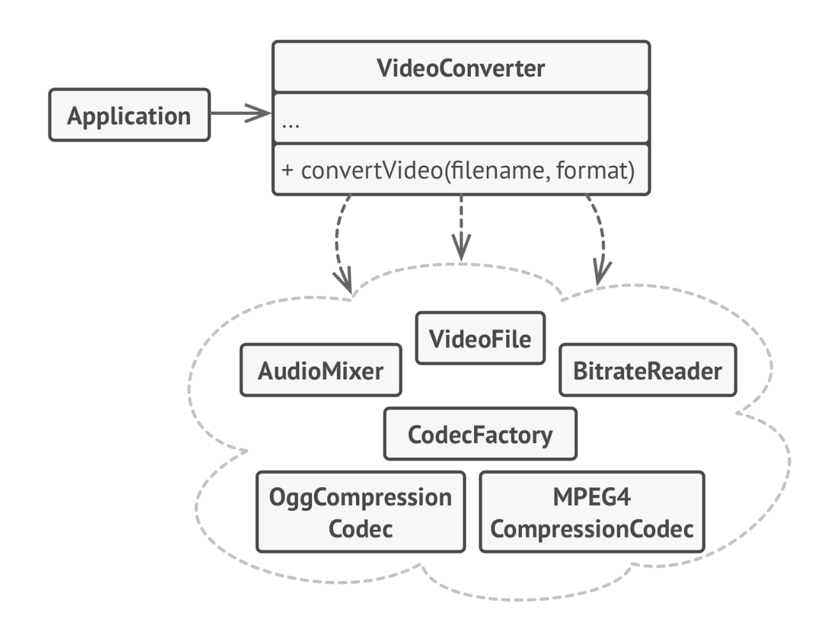
Facade
Provides a simplified interface to a complex set of libraries, frameworks or subsystems.
Provides a simplified abstraction to clients.

Slide 24
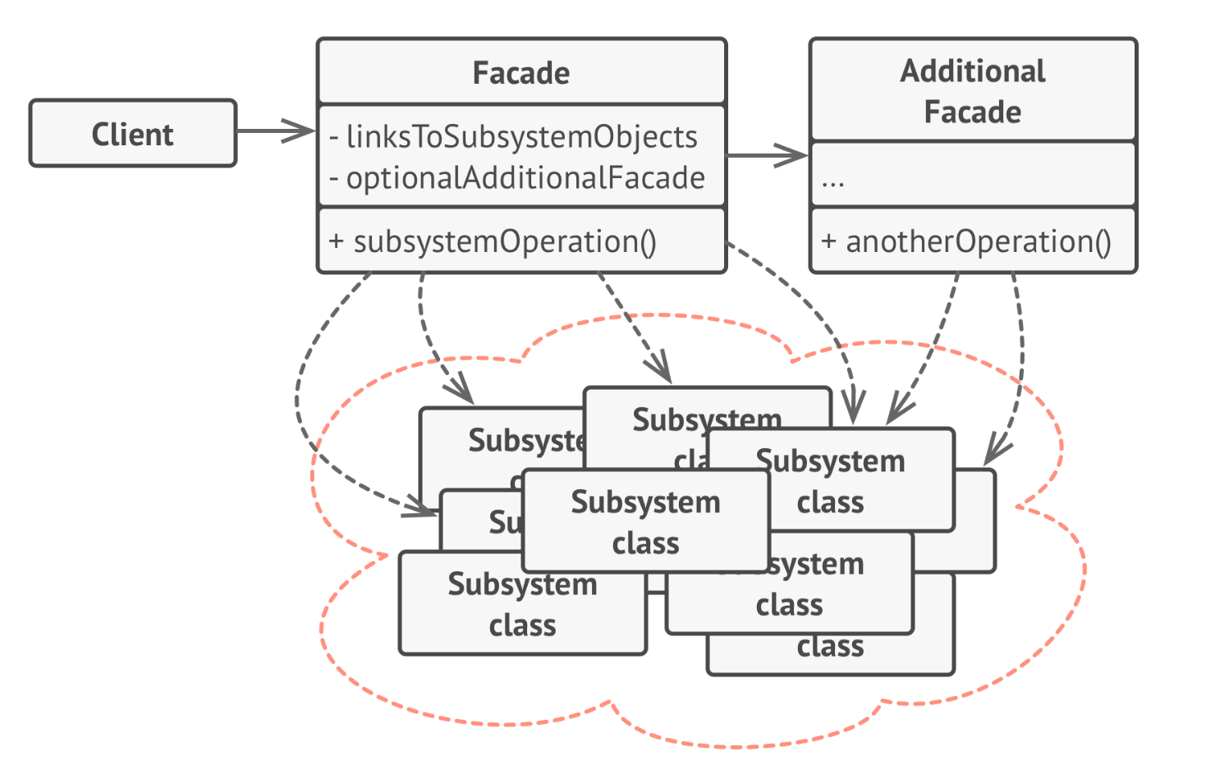
Facade Structure

Slide 25
Facade Characteristics
Isolates the clients from the complexity of subsystems.
God object coupled with all the subsystems

Slide 26
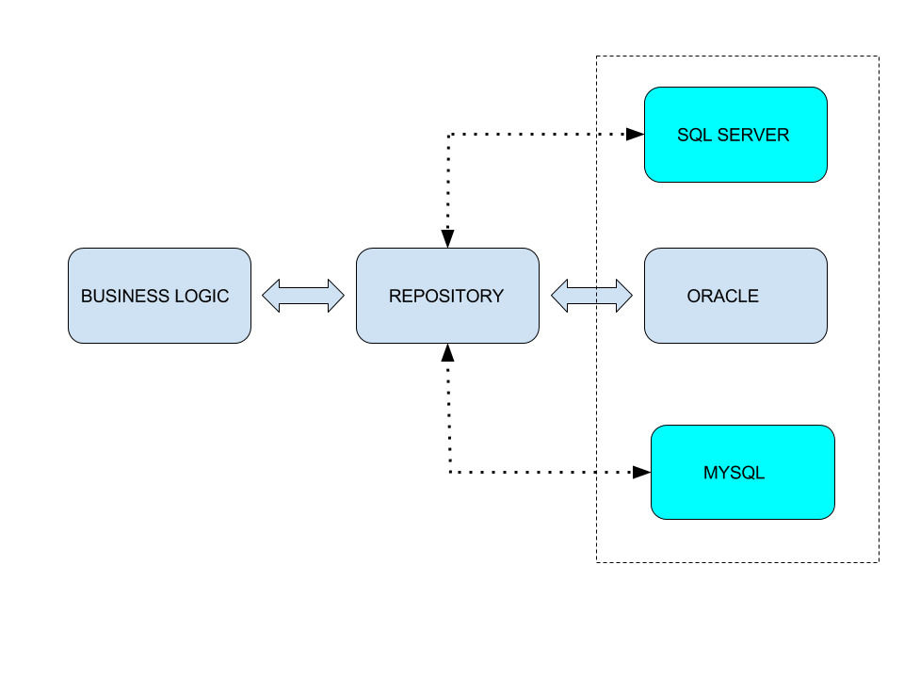
Repository
Creates an abstraction layer between the data access and the business logic layer

Slide 27
Repository Characteristics
Minimizes duplicated query logic DRY
Open/closed principal. Implementing new persistence sources does not imply breaking changes
Client does not have details about persistence framework implementations
Testability
Overengineering. Not needed for simple cases

Slide 28
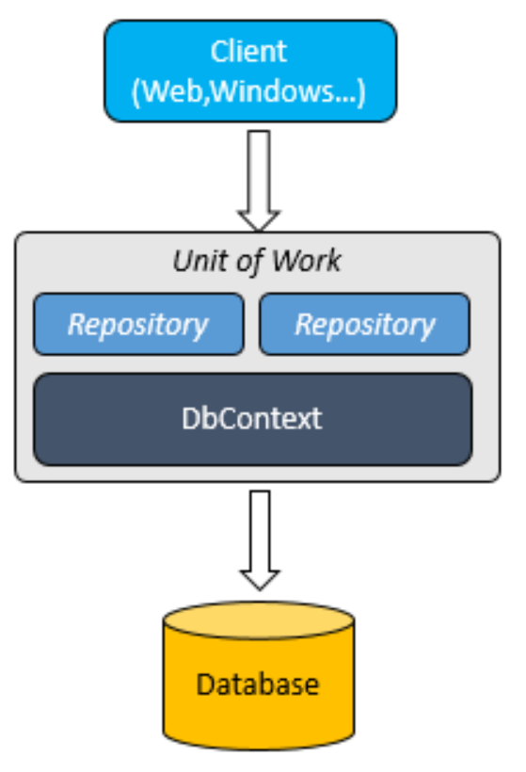
Unit of Work
Keeps track of all the changes produced in a business transaction and manages the storing of these changes.
Coordinates the work of multiple repositories by creating a single database context shared by all of them.

Slide 29
Unit of Work Characteristics
Maintains a list of business objects that has been modified during a transaction.
When the transaction is completed, all the updates are sent as an atomic operation to the database.
Mantains a single database session.

Slide 30
4. Behavioral Patterns

Slide 31
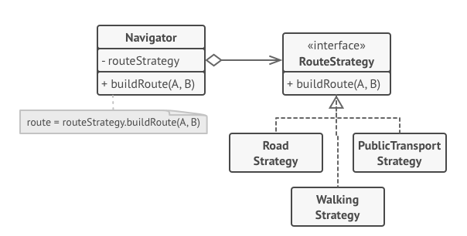
Strategy
Define a set of strategies, encapsulate each one, and make them interchangeable.

Slide 32
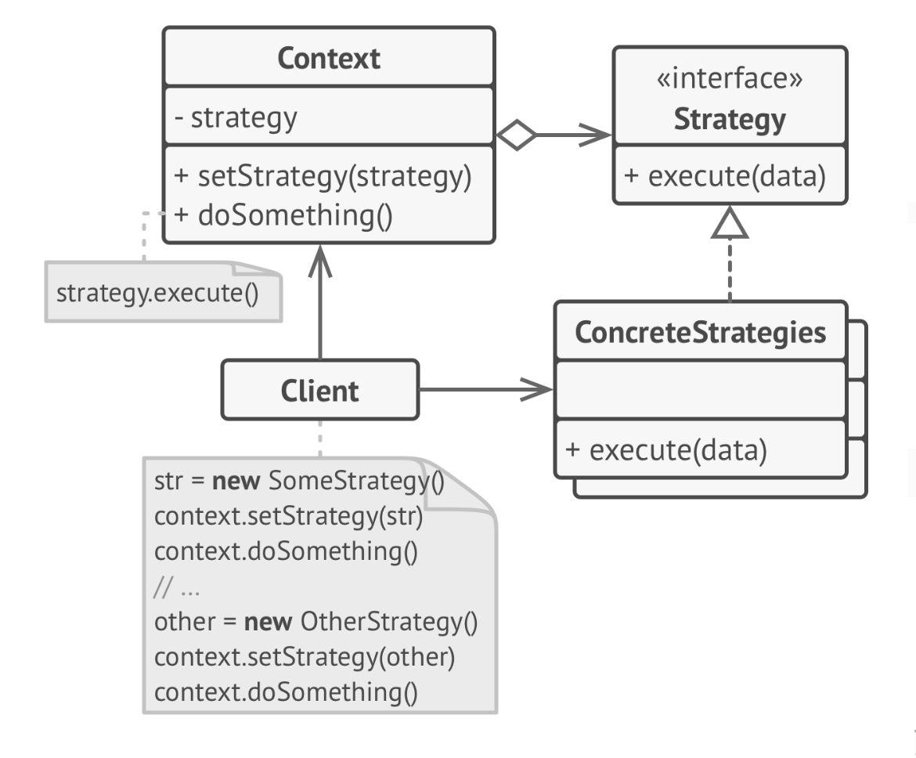
Strategy Structure

Slide 33
Strategy Characteristics
Swaps strategies at runtime
Isolates the implementation details of the algorithm from the code that uses it
Open/Closed Principle. Extension of new strategies without having to change the context.
Clients must know the different strategies
Overcomplicated for cases where a few strategies are applied and rarely change.
Most of modern programming languages provides support for it.

Slide 34
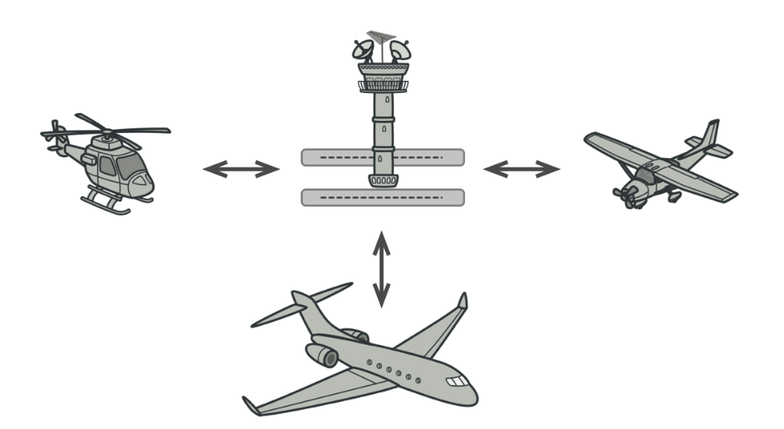
Mediator
Restricts communication between objects forcing them to communicate through a mediator.

Slide 35
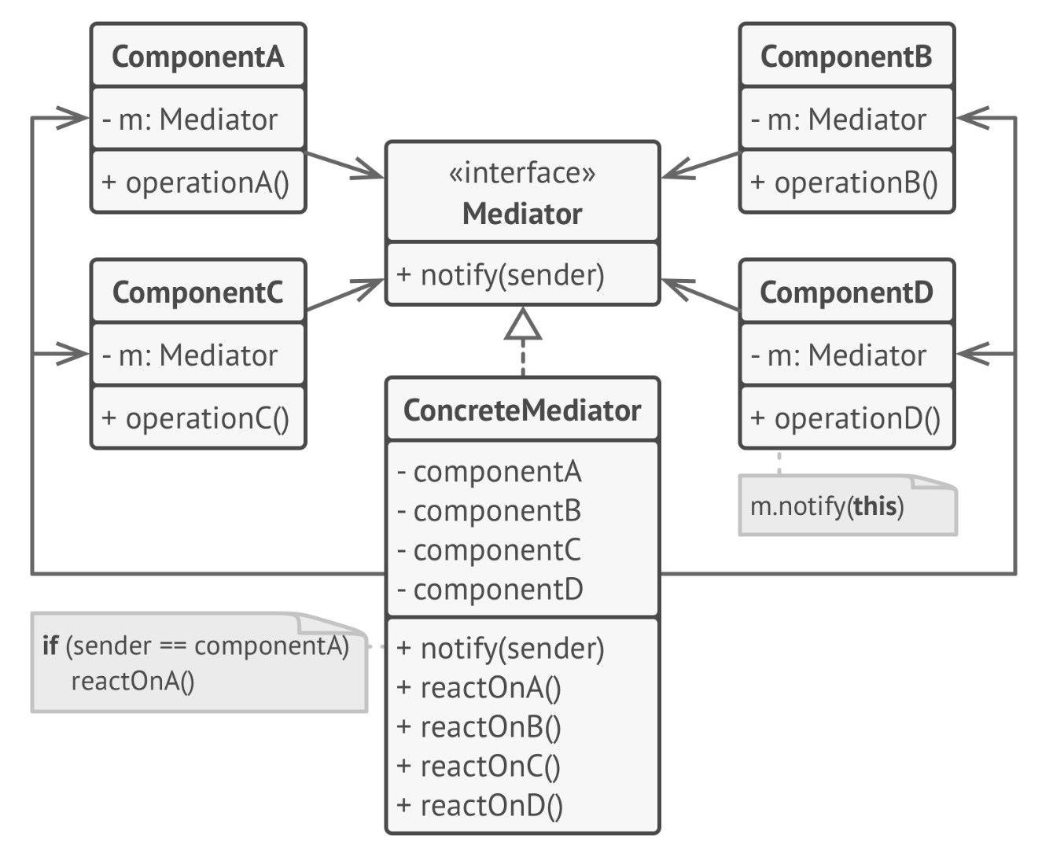
Mediator Structure

Slide 36
Mediator Characteristics
Single Responsibility Principle. The communication between peers is extracted out into a mediator component.
Open/Closed Principle. Adding more peers does not affect the existing ones.
Promotes loose coupling by keeping objects from referring to each other explicitly.
The mediator class might become a god object.

Slide 37
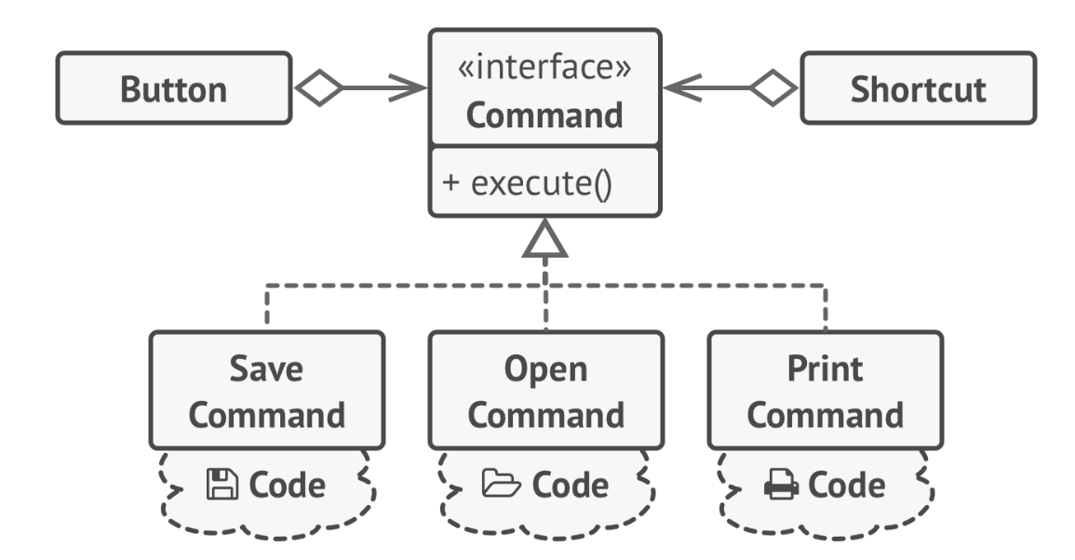
Command
Encapsulate a request as an object, thereby letting you parametrize clients with different requests, queue or log requests, and support undoable operations.
Send requests to objects without knowing anything about the operation being requested or the receiver of the request.

Slide 38
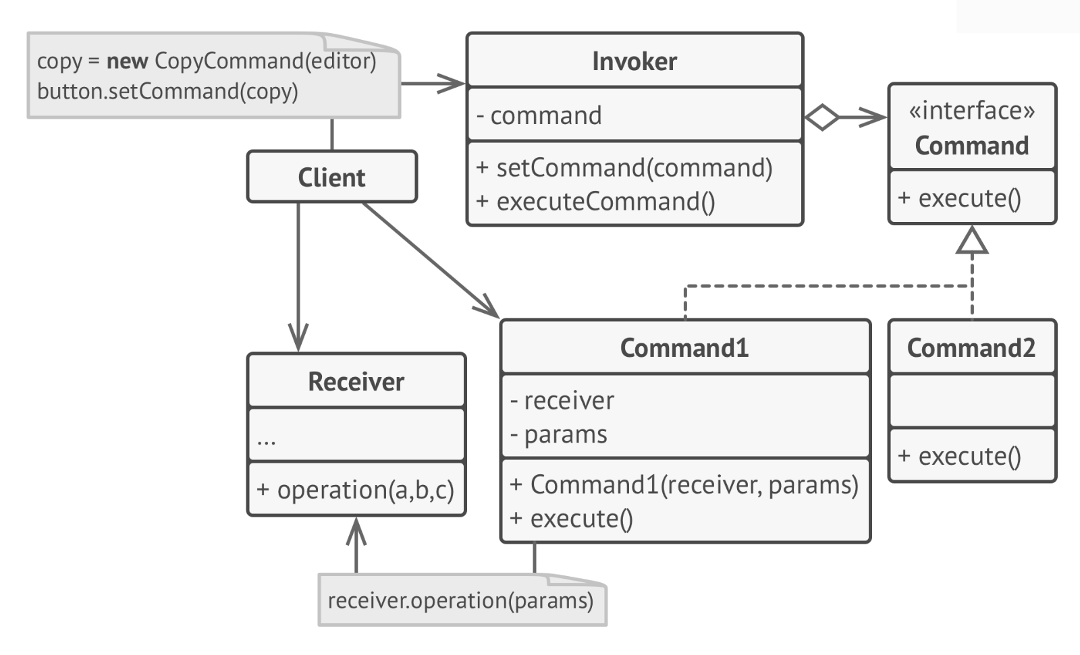
Command Structure

Slide 39
Command Characteristics
Single Responsibility Principle. Decouples classes that invoke operations from classes that perform these operations.
Open/Closed Principle. Introduction of new commands without breaking changes.
Allows to implement redo/undo operations.
Allows to implement deferred execution of operations.

Slide 40
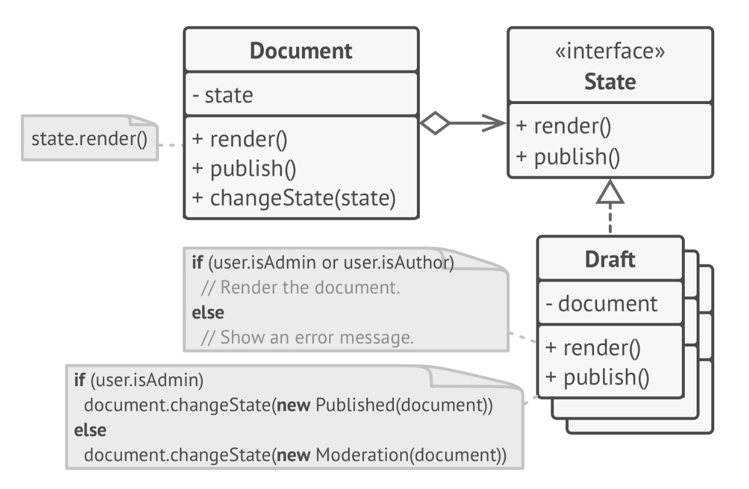
State
Allows objects change their behavior when its internal state changes.

Slide 41
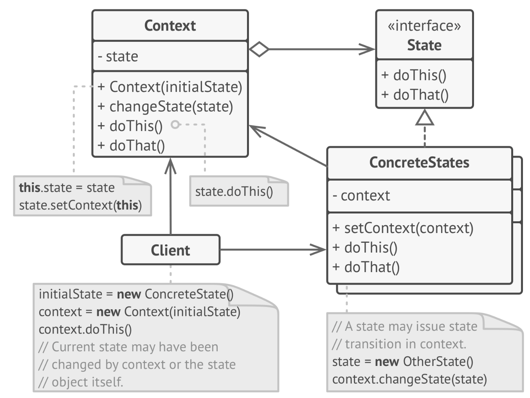
State Structure

Slide 42
State Characteristics
Single Responsibility Principle. Encapsulate code related to a particular state.
Open/Closed Principle. Introduction of new states without breaking changes.
More maintainable code eliminating state machine conditionals.
Overkill for a simple state machine with few states.

Slide 43
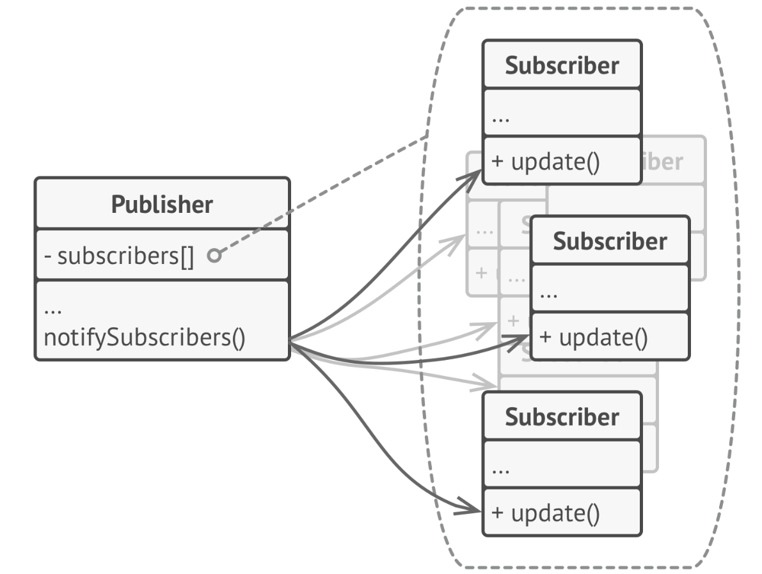
Observer
Allows to define a subscription mechanism to notify to all the observers about any event that happened to the observing object.

Slide 44
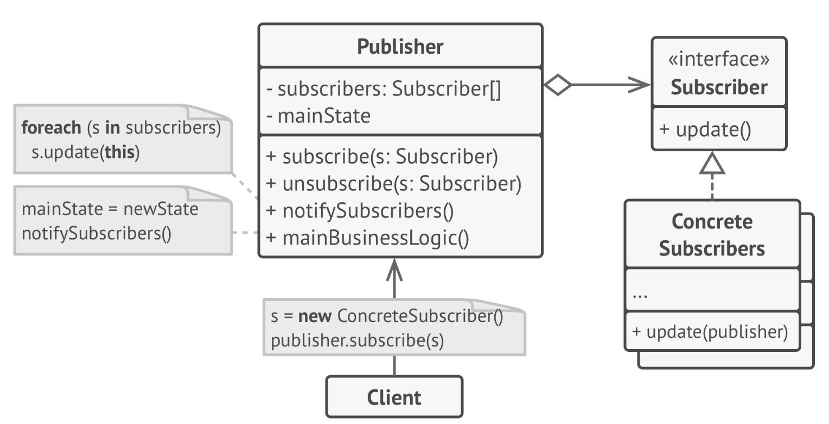
Observer Structure

Slide 45
Observer Characteristics
Open/Closed Principle. Introduction of new subscribers without having to change the publisher
Not need to know the set of observers beforehand.
Observers can change at runtime without affecting the publisher.
It cannot ensure an order of notification.

Slide 46
¡Thank you!
www.plainconcepts.com
@plainconcepts

